Slide 1




PROJECT MANAGEMENT PRESENTATION-03
Presentation by Group “Kalboishakhi”

Slide 2
TEAM MEMBERS
Nusrat Hossain
Muhammad Sabbir Hossain
Ibrahim
Soumitro Sarkar
Afia Jahin Ela

Slide 3
WHAT IS CHANGE CONTROL ?
Change control is a process for evaluating, approving, and managing changes to ensure only beneficial and cost-effective changes are implemented in a project.

Slide 4




CHANGE CONTROL BOARD(CCB)
The Change Control Board (CCB) is essential for effective change control in a project. It includes key decision-makers with the authority to make significant changes, such as-
Project manager
A stakeholder or user advocate
A team member who understands the effort involved
A person knowledgeable about engineering decisions
Someone who is familiar with the expected functionality

Slide 5
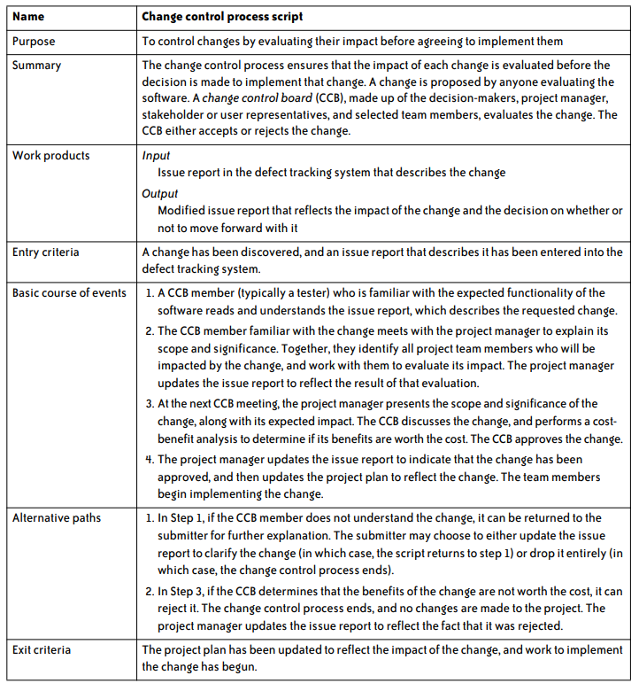
CHANGE CONTROL PROCESS SCRIPT

Slide 6
COCOMO METHOD
(COnstructive COst MOdel) model is an empirical and algorithmic based model that was derived by collecting data from a large number of software projects.
Boehm's COCOMO hierarchy consists of three models:
Basic COCOMO estimates effort and cost based on program size in lines of code (LOC).
Intermediate COCOMO adds cost drivers related to product, hardware, personnel, and project attributes.
Advanced COCOMO includes the intermediate model's factors and assesses the impact of cost drivers on each step of the software engineering process.

Slide 7
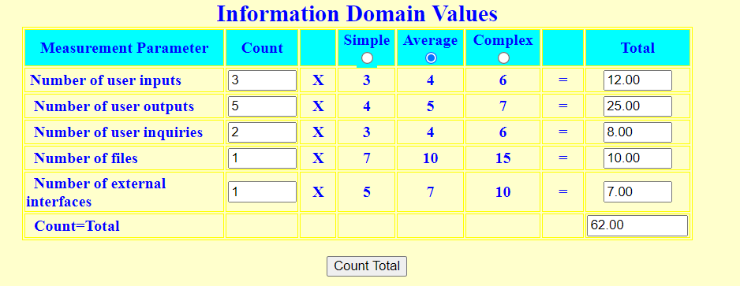
FOUR STEPS OF COCOMO MODEL
Step-1: The user should fill the Information Domain table in which he/she can get the Count Total (CT) which will be used in the FP equation.

Slide 8

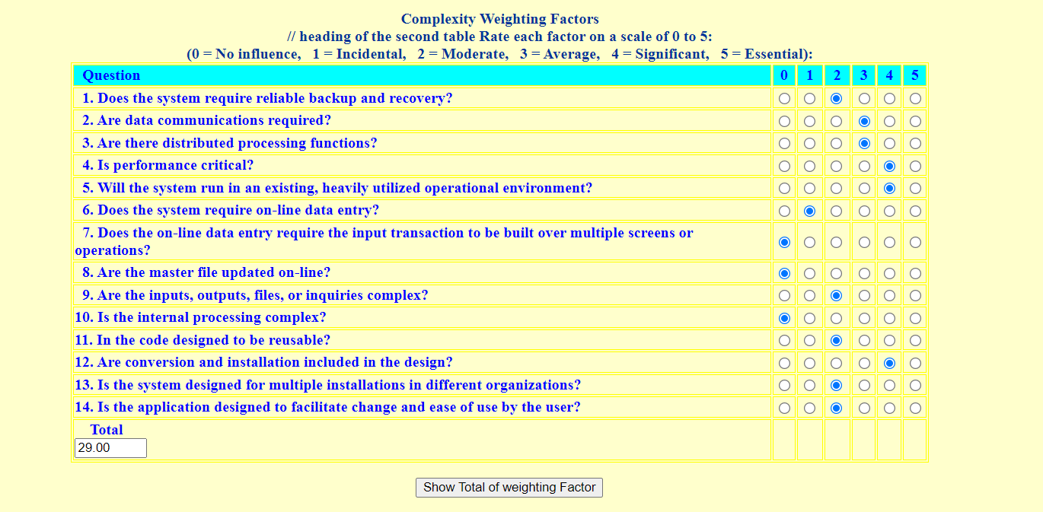
FOUR STEPS OF COCOMO MODEL
Step-2: The end user assigns a value (0 to 5) to each of the 14 complexity factors (∑Fi). After completing steps 1 and 2, the Function Points (FP) are calculated using the formula:

Slide 9
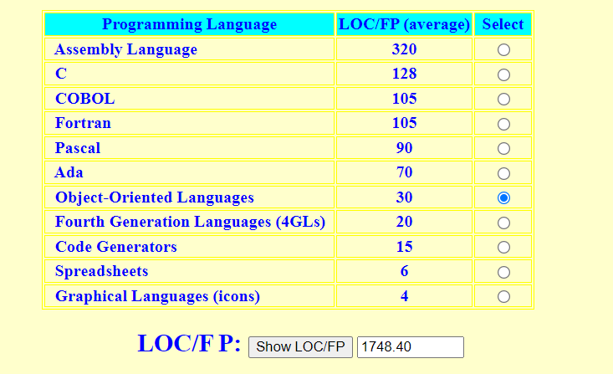
FOUR STEPS OF COCOMO MODEL
Step-3: The user selects a programming language from a table, calculates the LOC per function point, and determines the required KLOC for the project.

Slide 10

FOUR STEPS OF COCOMO MODEL
Step-4: This is the final step of the basic COCOMO model. Here we will find Efforts and Duration of the project.

Slide 11
COCOMO MODEL COST ANALYSIS
The relationship between project staff, total effort, and development time is nonlinear.
There are three parameters involved in computing the Total Cost of a software development project:
Hardware and software costs including maintenance
Travel and training costs
Effort costs (the costs of paying software engineers)
Effort costs refer to the total amount of work, resources, and time required to complete a project or task. These costs typically include labor hours, materials, and other resources necessary to achieve project goals.

Slide 12
PROJECT MANAGEMENT TOOLS
A project management tool is software that helps project managers and teams plan, organize, and manage their projects.
ADVANTAGES OF PROJECT MANAGEMENT TOOLS
TASK ORGANIZATION: CENTRALIZED PLATFORM FOR MANAGING TASKS, DEADLINES, AND PRIORITIES.
COLLABORATION: IMPROVES TEAM COMMUNICATION WITH SHARED BOARDS AND REAL-TIME UPDATES.
RESOURCE MANAGEMENT: HELPS ALLOCATE AND TRACK TEAM MEMBERS’ WORKLOAD AND
AVAILABILITY.

Slide 13
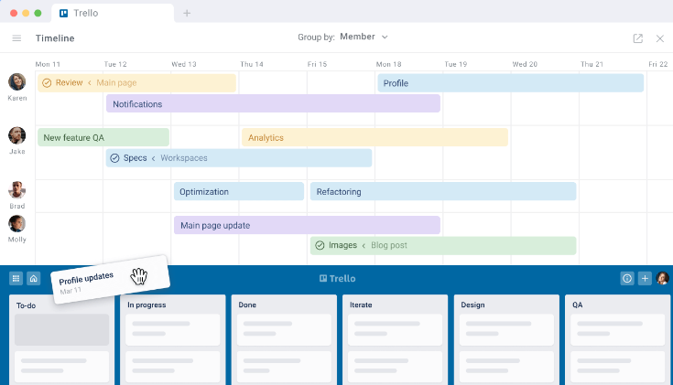
TRELLO
OVERVIEW
Created: 2011 by Fog Creek Software (Joel Spolsky, Michael Pryor)
Popularity: Over 50 million users worldwide.
Packages: Free, Standard, Premium, Enterprise.
Notable Features: Kanban boards, Power-Ups (integrations), easy-to-use.

Slide 14
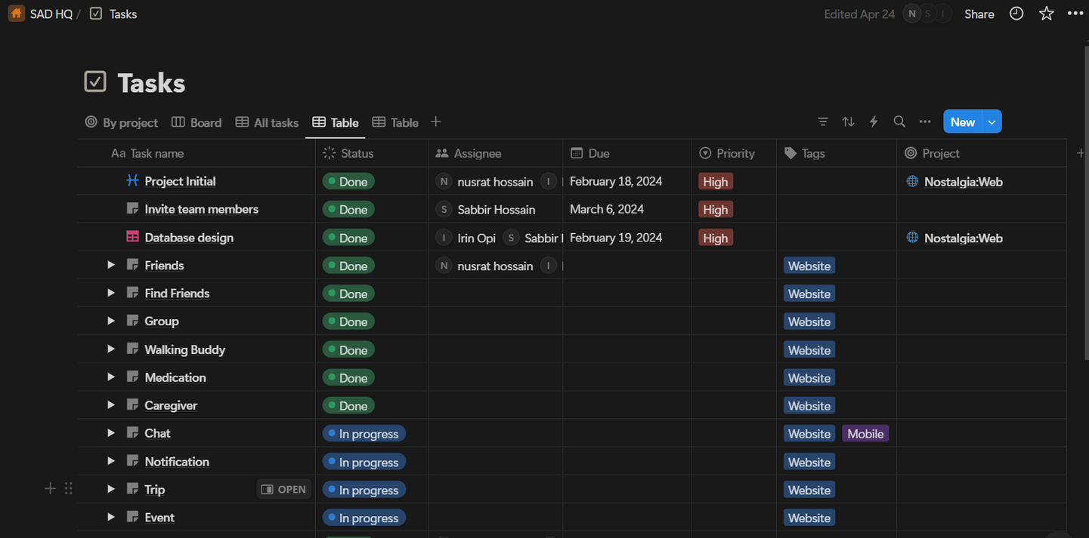
NOTION
OVERVIEW
Created: 2013 by Ivan Zhao and Simon Last.
Popularity: Used by millions of users, especially by startups and personal projects.
Packages: Free, Personal Pro, Team, Enterprise.
Notable Features: All-in-one workspace, notes, databases, wiki, and more.

Slide 15
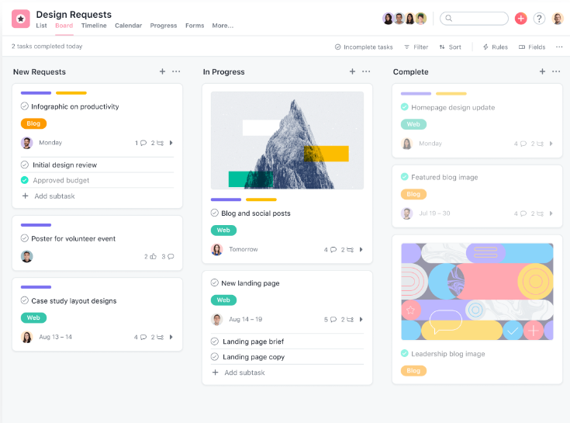
ASANA
OVERVIEW
Created: 2008 by Dustin Moskovitz and Justin Rosenstein.
Popularity: 140,000+ paying customers, widely adopted for task management.
Packages: Basic, Premium, Business, Enterprise.
Notable Features: Task management, project tracking, team communication.

Slide 16
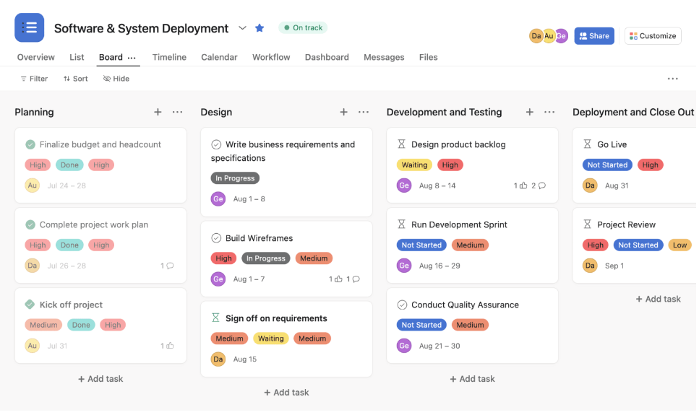
MONDAY.COM
OVERVIEW
Created: 2012 by Roy Mann, Eran Zinman.
Popularity: Over 180,000 organizations use it globally.
Packages: Individual, Basic, Standard, Pro, Enterprise.
Notable Features: Visual project tracking, custom workflows, automation.

Slide 17
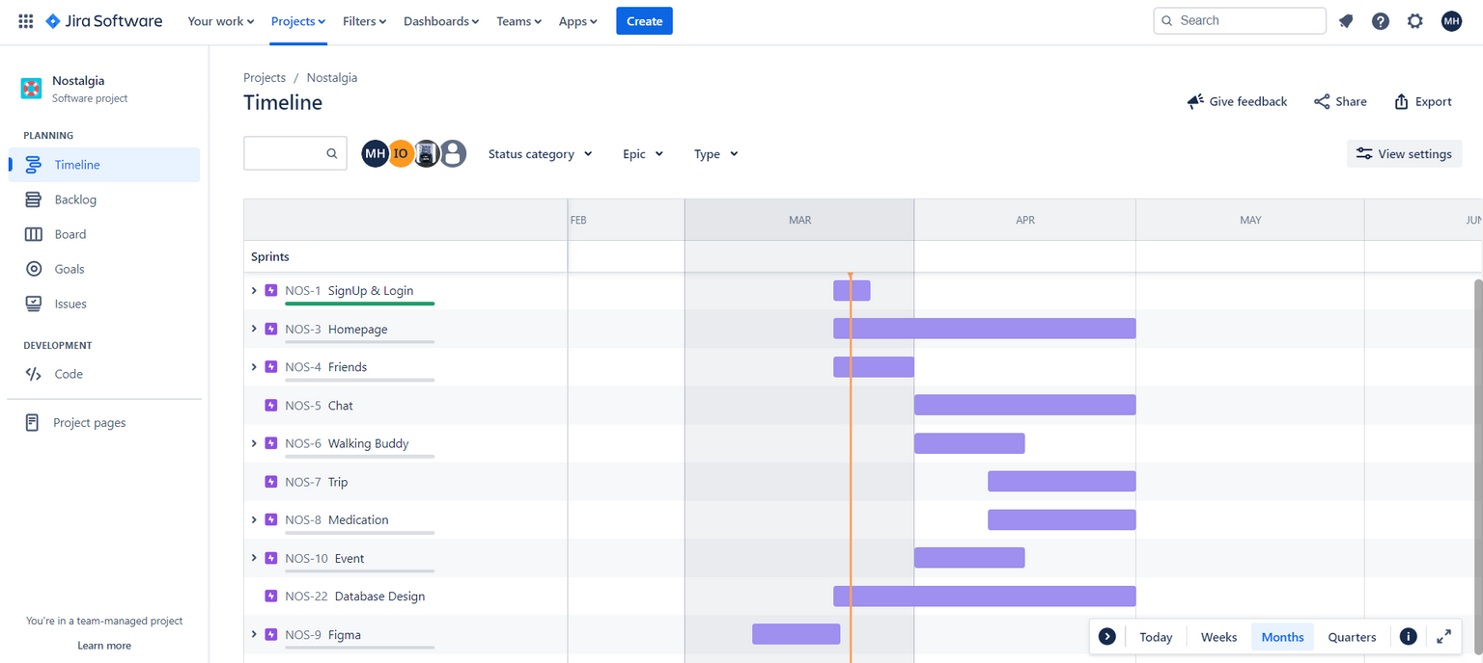
JIRA
OVERVIEW
Created: 2002 by Atlassian (Scott Farquhar, Mike Cannon-Brookes).
Popularity: A leading tool for Agile teams, especially in software development.
Packages: Free, Standard, Premium, Enterprise.
Notable Features: Scrum/Kanban boards, bug tracking, sprint planning, reports.

Slide 18


BENCHMARK OF PMG TOOLS
Features | Trello | Notion | Asana | Monday.com | Jira
Task Management
Custom Workflows
Time Tracking
Agile/Scrum Support
Bug Tracking
Time tracking
Reporting & Analytics

Slide 19
WHY WE USING JIRA (SCRUM) FOR OUR PROJECT?
AGILE-FOCUSED TOOL
TAILORED FOR AGILE/SCRUM METHODOLOGIES WITH BACKLOG MANAGEMENT, SPRINT PLANNING, AND SCRUM BOARDS.
COMPREHENSIVE SPRINT PLANNING
EFFICIENT TASK ASSIGNMENT AND PROGRESS TRACKING WITH FLEXIBILITY TO ADJUST SPRINTS.
CUSTOMIZABLE WORKFLOWS
CREATE CUSTOM WORKFLOWS THAT MATCH OUR PROJECT NEEDS WITH AUTOMATED TASK TRANSITIONS.
REPORTING & ANALYTICS
IN-DEPTH REPORTS LIKE BURNDOWN CHARTS AND VELOCITY REPORTS FOR TRACKING PROGRESS.

Slide 20
THANK YOU

